Slide 1
Scoileanna Ildánacha
CA training day
10 October 2023

Slide 2
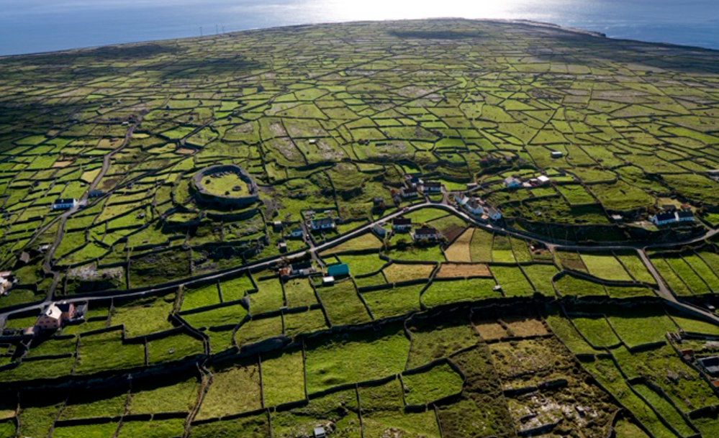
Professional development, support and exchange
CPW/
Safeguarding
training
National induction training for new CAs
National
CA training day
Regional
CA training events
CA Communities of Practice
Three scheduled meetings with your RC
Spring updates
Open door

Slide 3
Schedule
September 2023
CPW/Safeguarding training
October 2023
CA national training in Richmond Barracks

Slide 4
October – December 2023
Meeting #1 with your Regional Coordinator (RC)
CA community of practice meeting
Regional training

Slide 5
January – June 2024
Meeting #2 with your RC
CA community of practice meeting
Regional training
Spring updates
Meeting #3 with your RC
CA community of practice meeting

