Slide 1
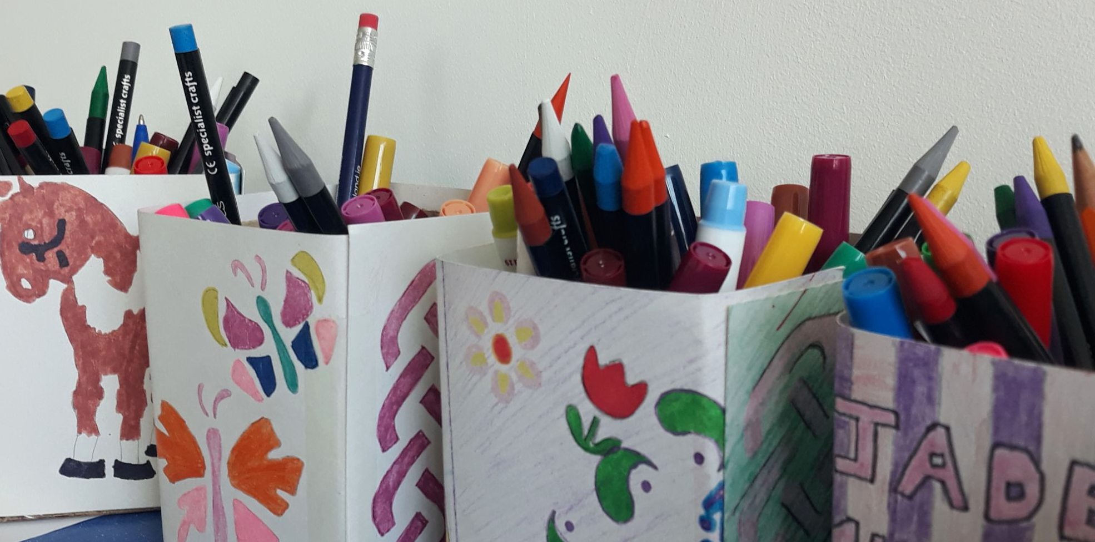
Youthreach Tuam 2020 - 2022
CREATIVE SCHOOLS CASE STUDY
Creative Associate Training 2023
Creative Associate Joanna McGlynn

Slide 2
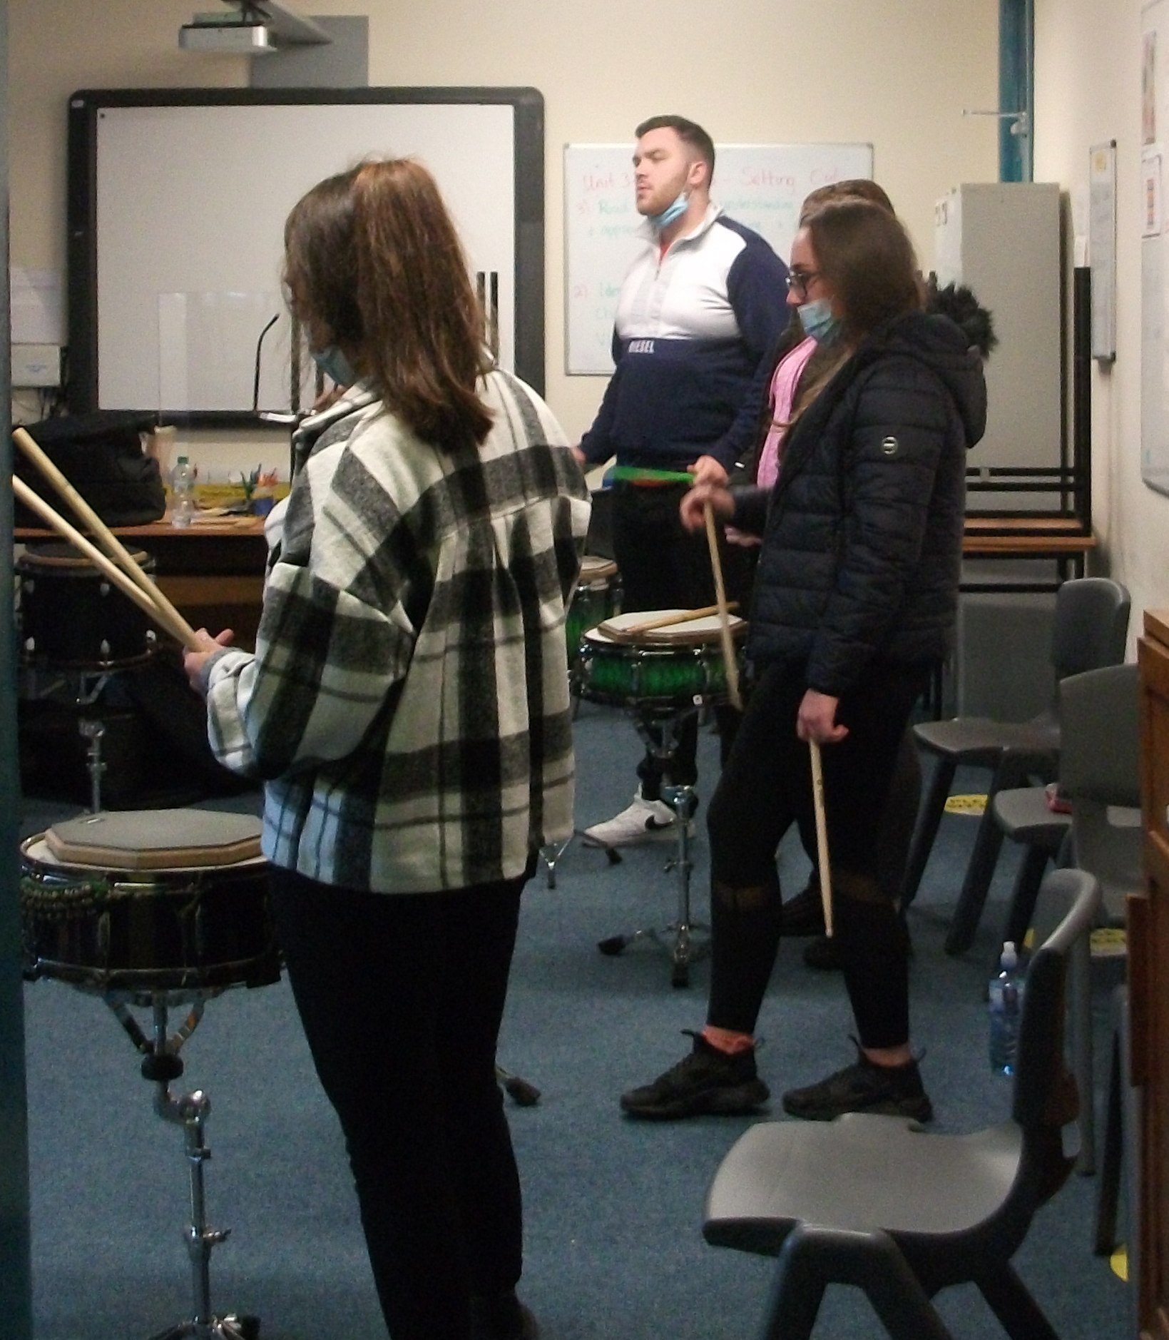
Context:
Tuam, Co. Galway
Approx 40 students
13 Staff
School Coordinator = shared position between Art Teacher & Centre Director

Slide 3
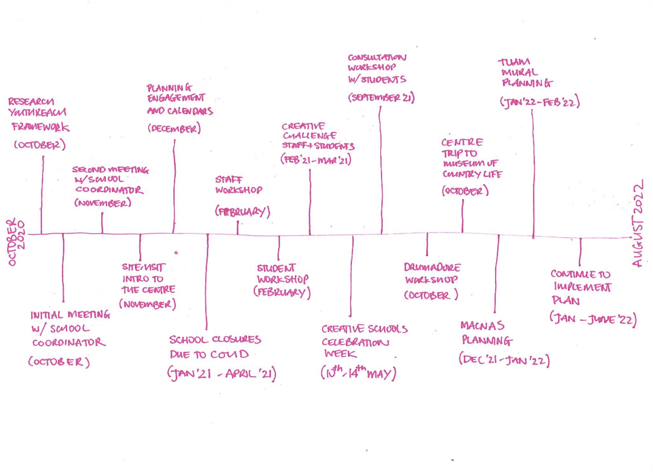
understand
Timeline 2020 - 2022 with a focus on the UNDERSTAND phase
THE CREATIVE SCHOOL JOURNEY
develop

Slide 4
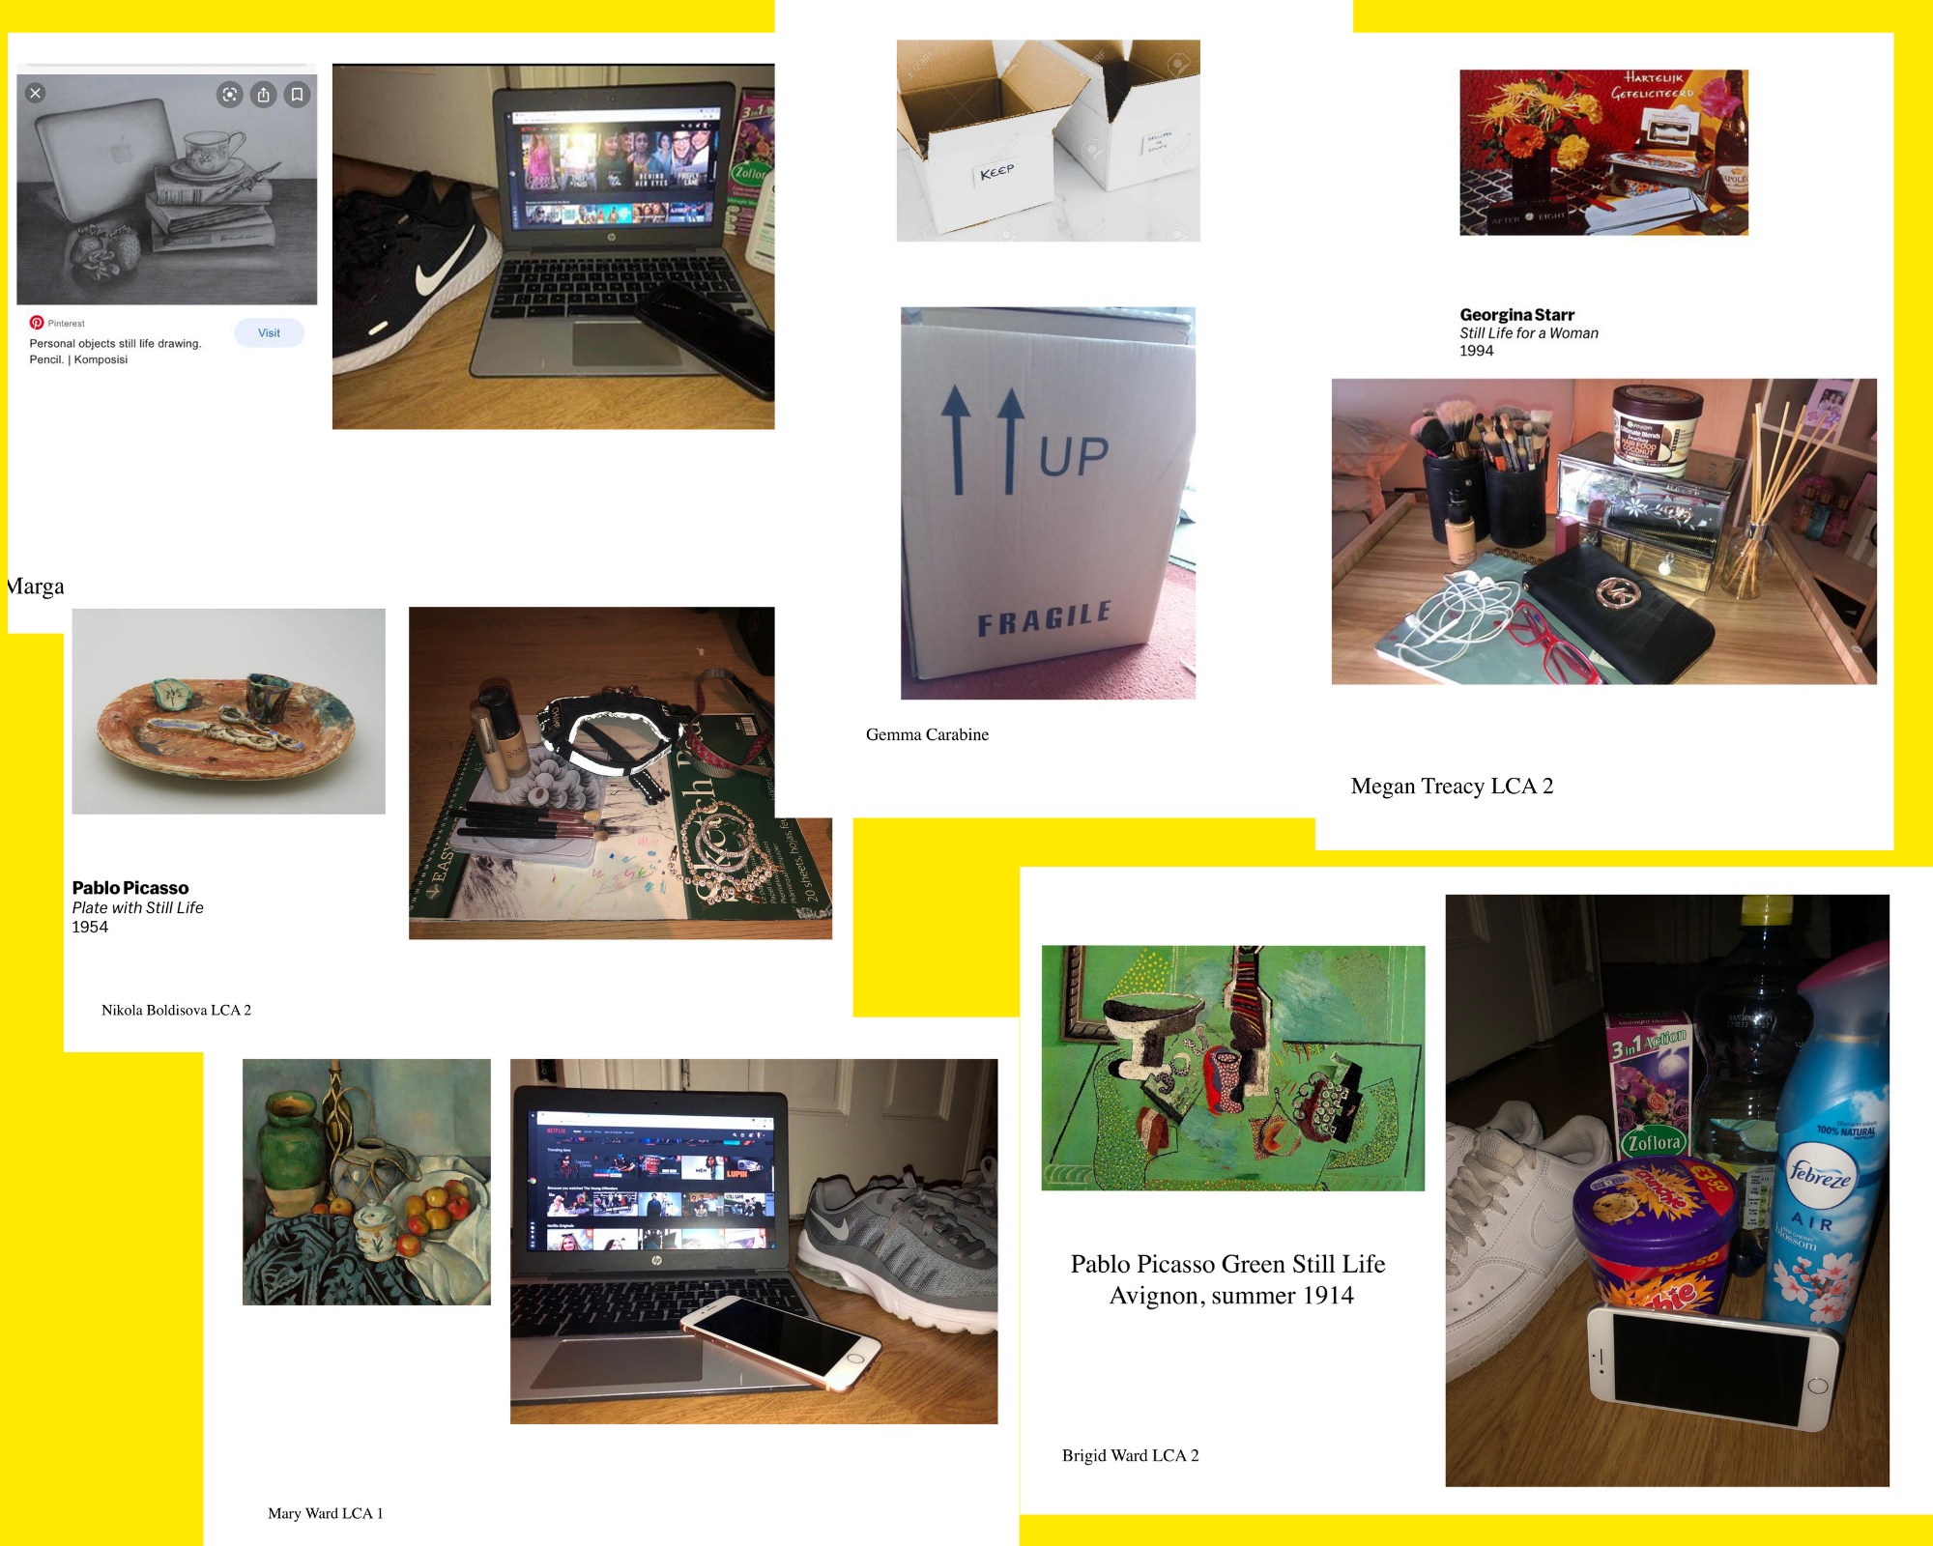
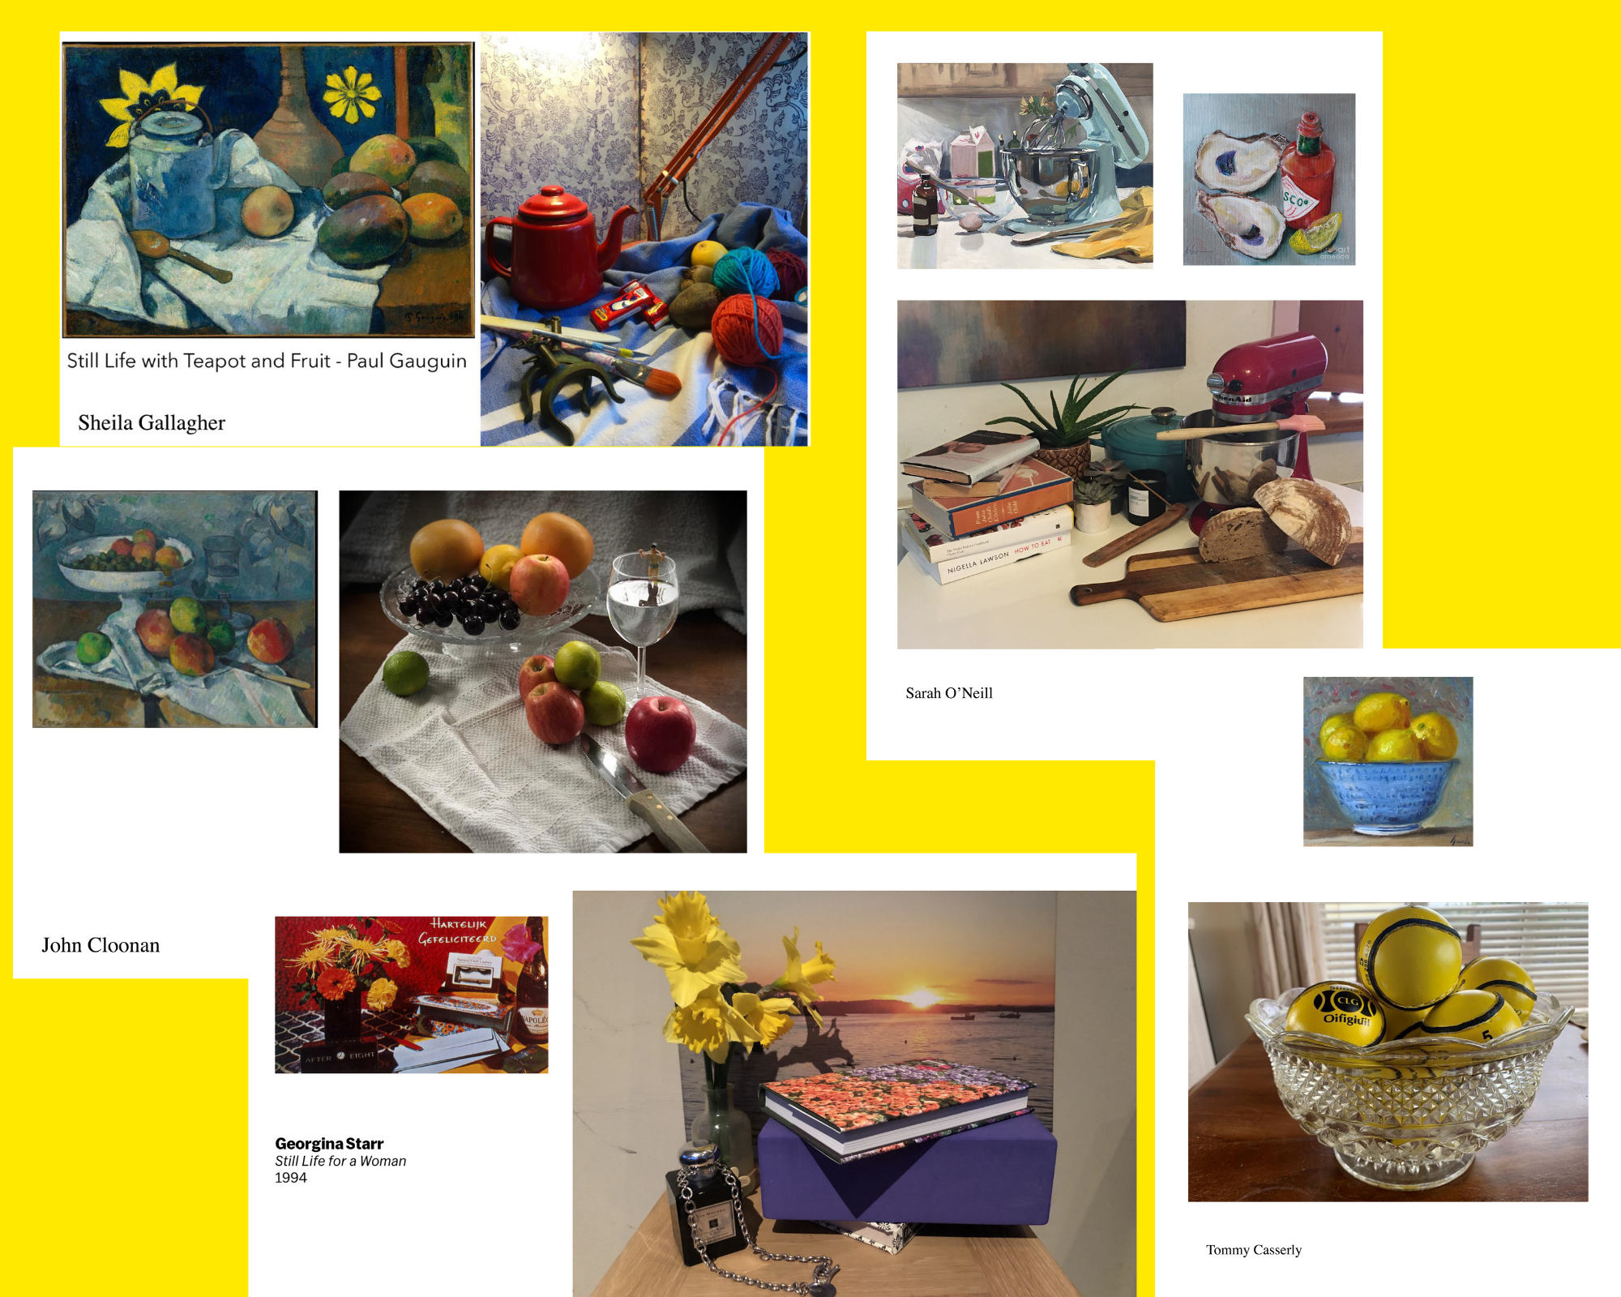
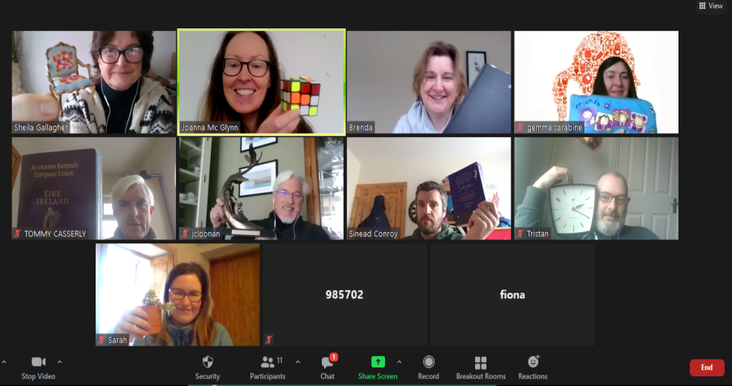
CONSULTATION PROCESS
Hybrid approach:
In-person meetings
Phone meetings
Online via Teams/Zoom
In-Centre observations
In-Centre consultations
Distance challenges / creative tasks
Online surveys
Voting processes
Notice boards

Slide 5
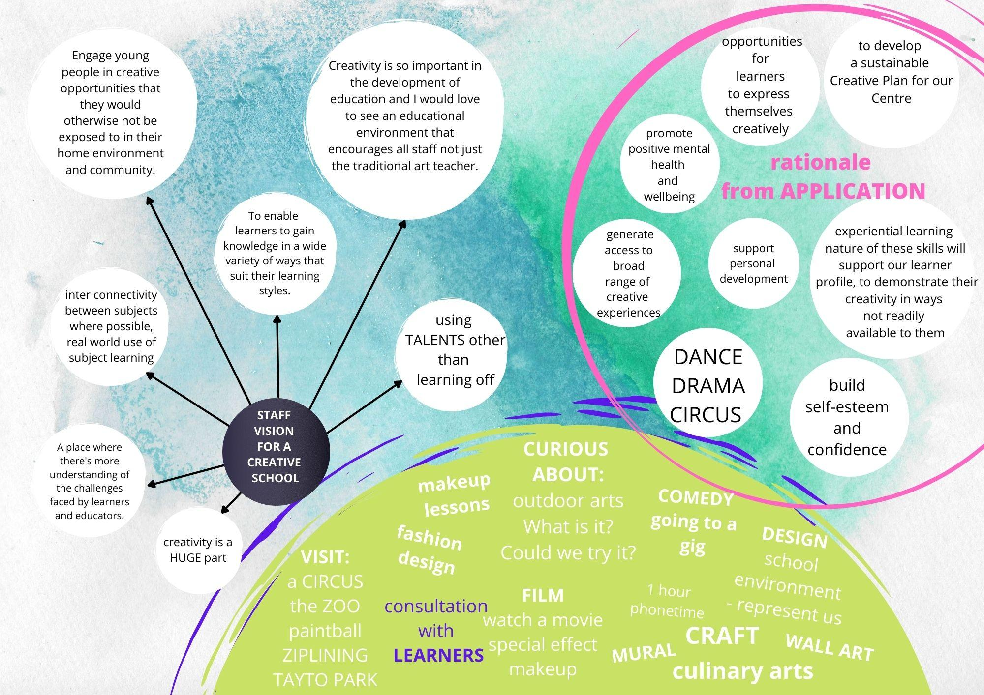
…collating the FINDINGS
from the understand phase...

Slide 6
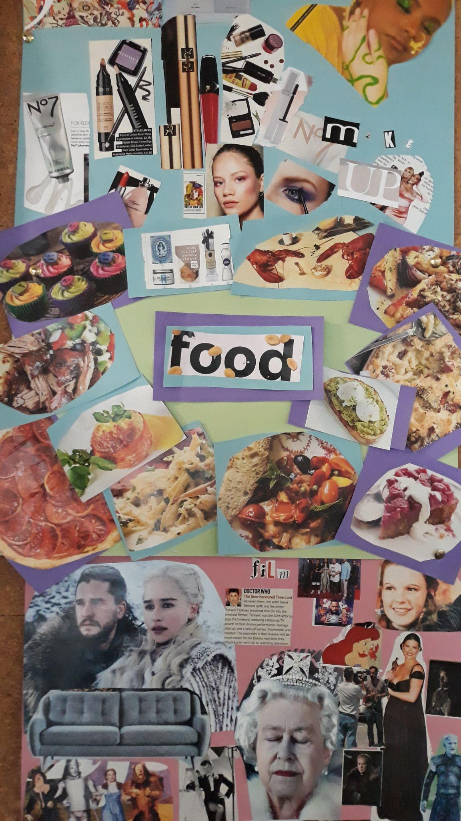
‘..embed creativity within the Centre by supporting learners and staff to recognise their diverse creative talents and providing opportunities to develop these along with increasing learners' access to a broad range of creative opportunities which might not otherwise be available…’
school vision

Slide 7
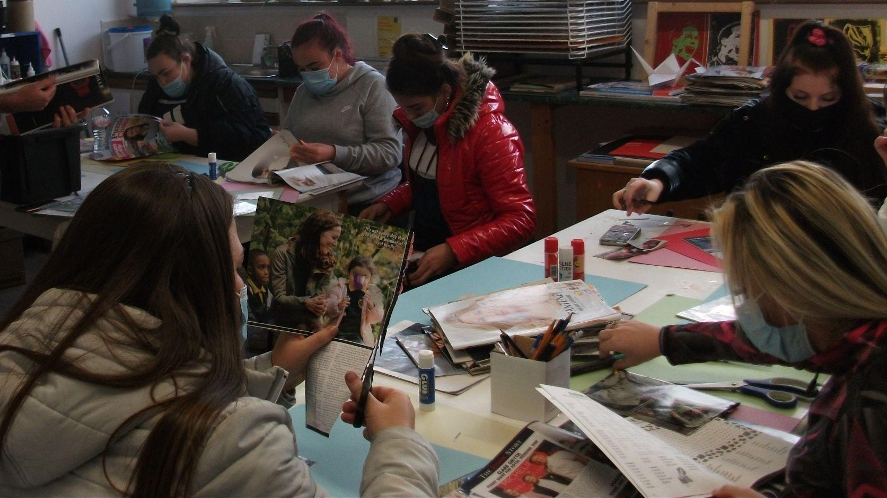
develop learner self-confidence, wellbeing and personal growth by supporting learners to develop their existing creative skills and providing opportunities to discover new creative skills
develop staff creativity by providing opportunities for connection with and exploration of their own creativity
develop a long term plan for creativity in the Centre through policy
aims of the creative school plan

Slide 8
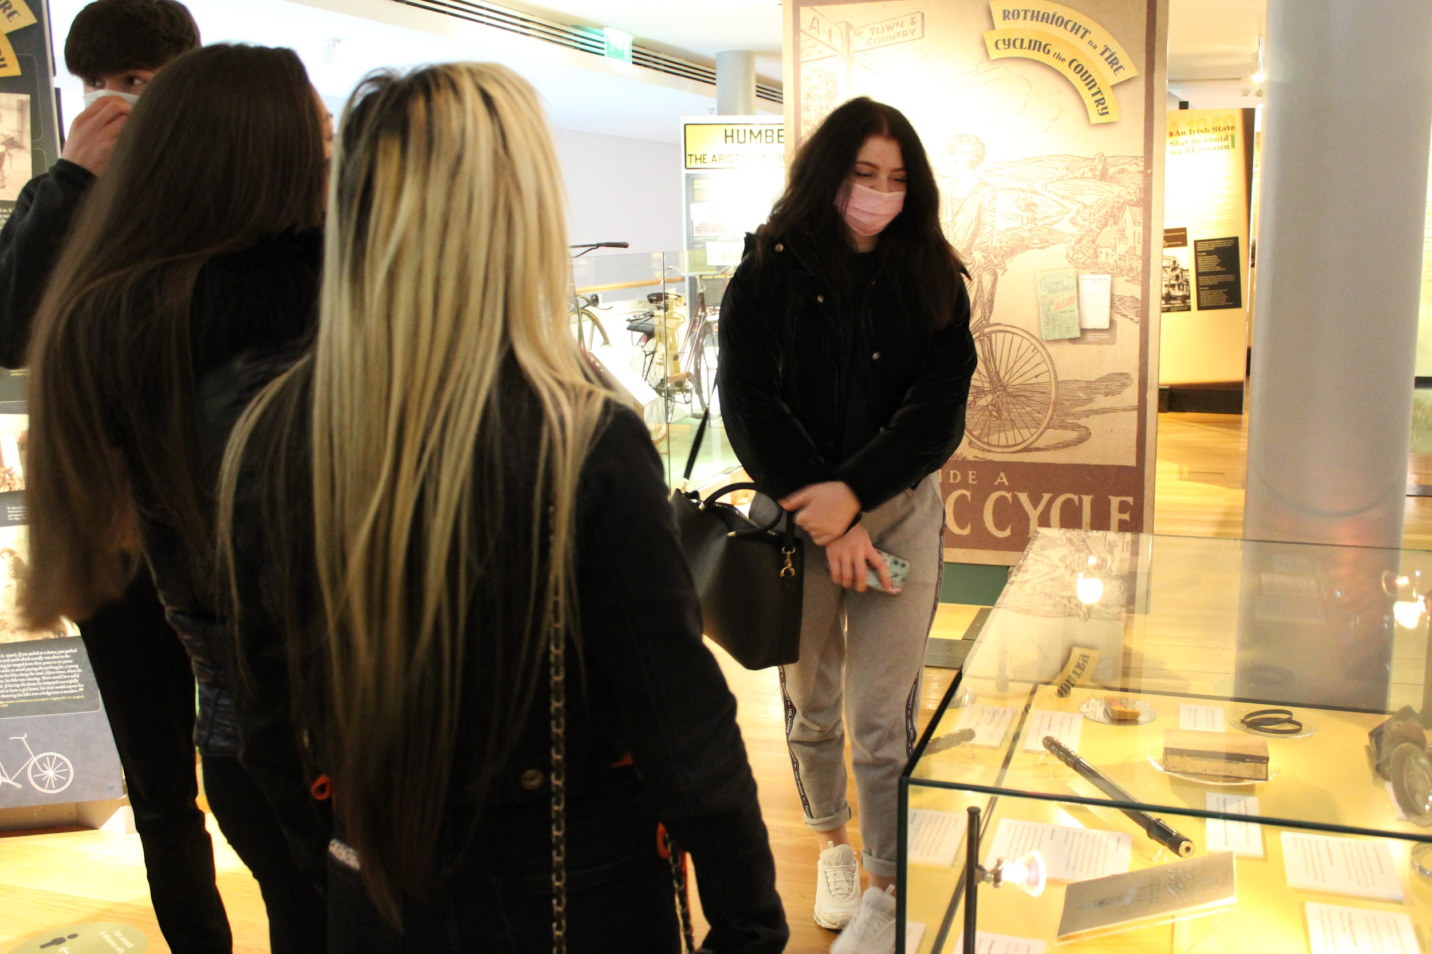
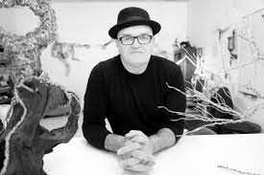
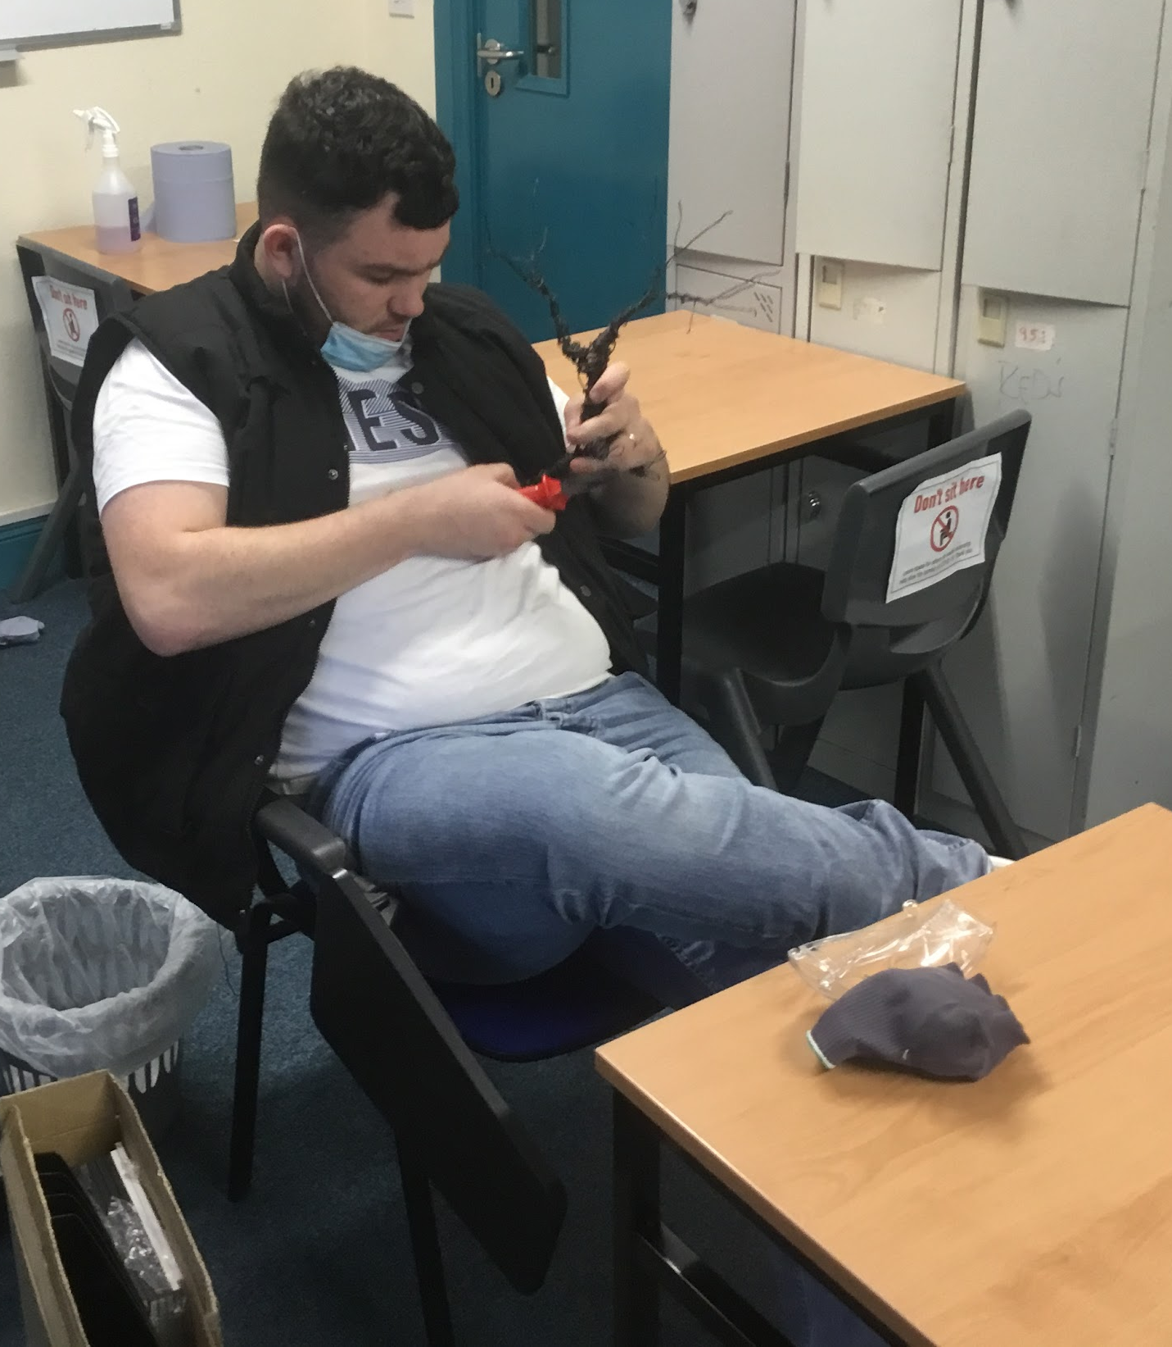
planning in progress
creative wire sculpture workshop led by Glenn Gibson of Art in Mind
visit to Museum of Country Life, Castlebar
develop

Slide 9
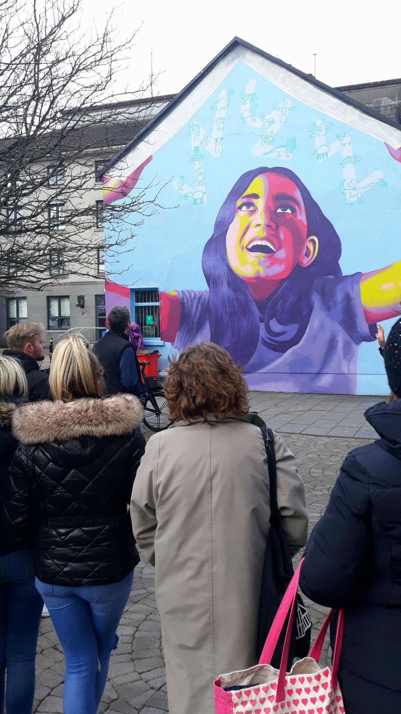
Creative School programme includes:
- Participation in Creative Schools Week May 2021
- Drumadore workshop to support working in cooperation and student integration September 2021
- Staff exploration of creativity in wire sculpting workshop with Art of Mind December 2021
- Field Trip to Museum of Country Life
- MACNAS workshop using drama to explore self expression and storytelling; March 2022 - May 2022
- Youth advisors on Tuam mural project using our voice in partnership with OPW, Galway County Arts Office & Creative Places Tuam; February 2022 - ongoing

