Slide 1
Your journey as a Creative School

Slide 2
Timeline for 2022 Creative Schools

Slide 3
Creative Schools: three phases
Develop your Creative School Plan
Begin to implement your Creative School Plan
Understand
Up to May/June 2023
2
1
June 2023 to June 2024
3
Notes:
Creative Schools offers a guided journey to schools and Youthreach centres. You go at your own pace through three main phases: The ‘understand’ phase runs until approximately May or June 2022, and gives your students and your school community time to explore and analyse what arts and creativity means to you and to your school; all the material, surveys, creative outputs and shared learnings from your ‘understand’ phase sets you up well for the second phase, which is a whole-school process to develop your Creative School Plan, which will include a vision and aims particular to your school, as well as priority actions and projects. Developing and agreeing your school’s Creative School Plan and beginning to carry out the initial actions and projects will take you from June 2022 to June 2023.

Slide 4
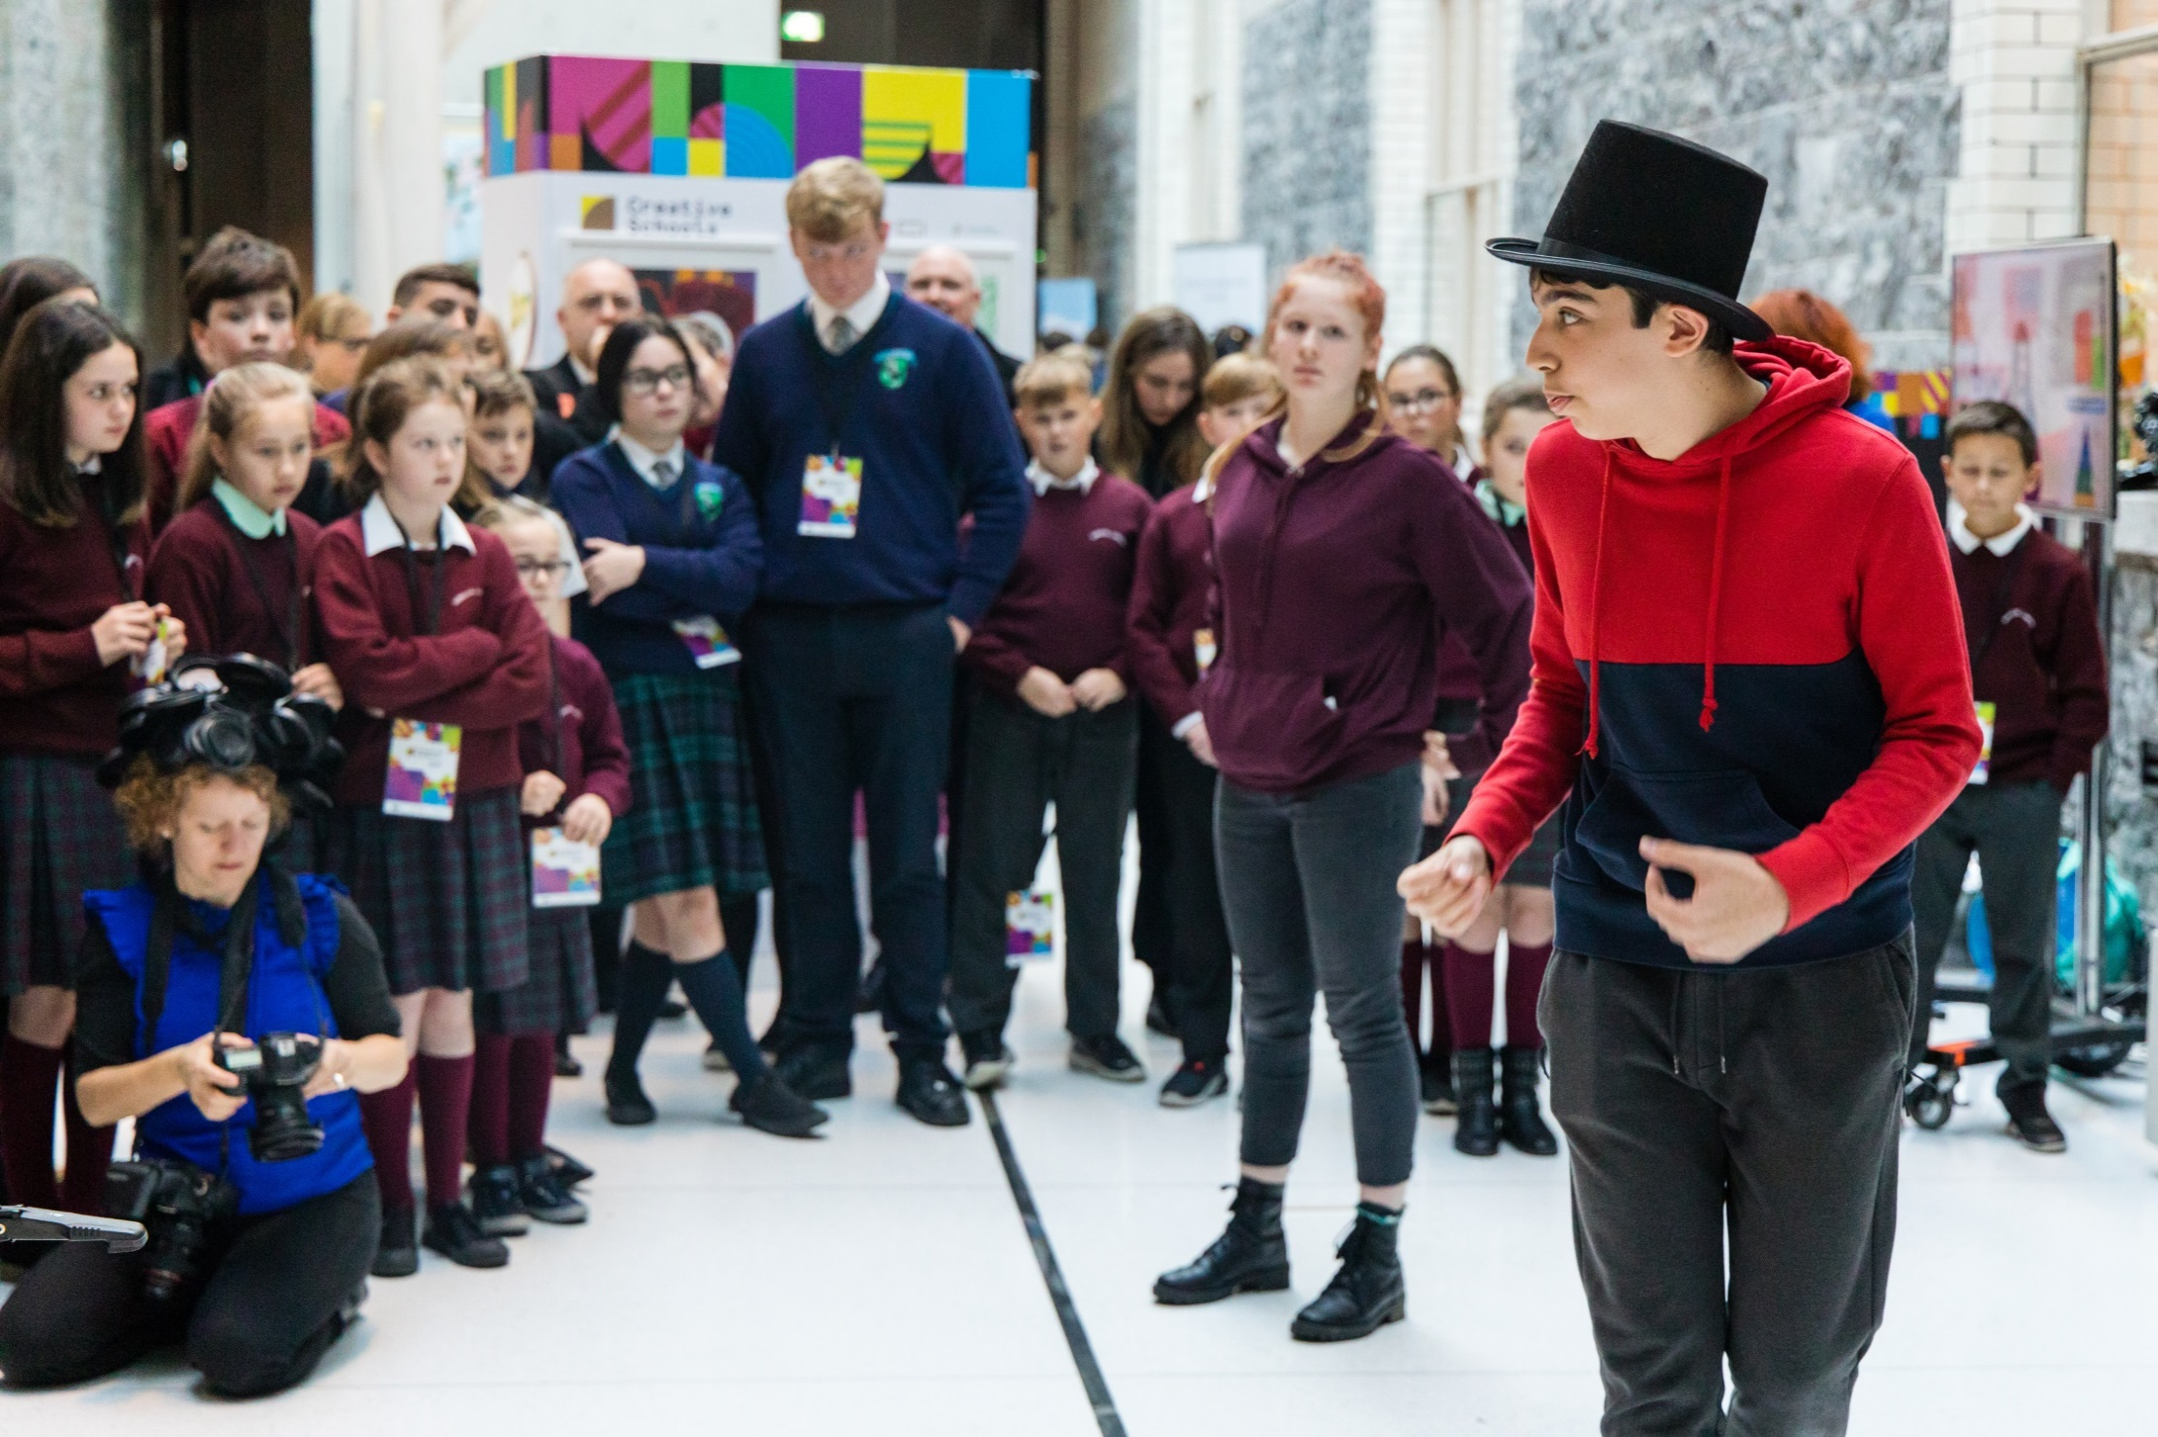
Up to May/June 2023: Understand
Building relationships with your CA
Learning about the CS initiative
Working with the children and young people in decision making
Connecting with the whole school community
Understanding Creativity in your school
Creative Conversations and feedback
Analysis of your engagement with the arts and creativity
Discovering the interests of your school community
Identifying strengths and areas for development
Researching opportunities
Workshops/activities
CA in regular contact
Notes:
Your CA will take time to establish a rapport with your school that will support effective working relationships between themselves, the staff and the students.
CAs will go about this relationship-building process in a variety of (creative!) ways.
They may also present themselves, their role and details of the CS programme to the wider school.
They will support your school to carry out an analysis of your current engagement with the arts and creativity and the current resources in your schools and wider community.
They will explore your school’s understanding of creativity and help you discover the artistic and creative experiences and interests of your school community.
Your CA will work with your School Coordinator (SC) to arrange creative conversations with the whole school community. This could, for example, take the form of setting up a student advisory group, teacher/parent surveys or student voice workshops.
Through this process your school’s strengths and areas for development are identified.
While working on this analysis your school might consider pilot workshops, activities or research.

Slide 5
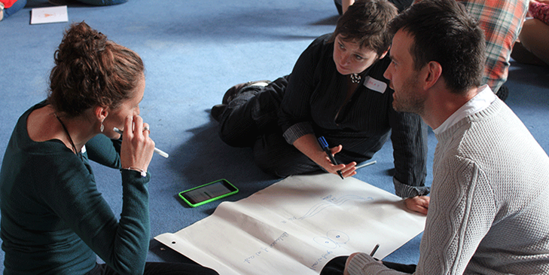
May/June 2023 – June 2024
Addressing individual priorities and needs
Researching opportunities
Develop CS Plan
Forming links between the school and arts and creative community
Liaising with Creative practitioners and cultural institutes and organisations.
Activities taking place
Celebrating your achievements
Evaluation and reflection
Embedding the CS Plan
Ongoing consultation
Regular contact for CA and school
Notes:
May/June 2022– June 2023
At this point, your CA will begin to research ways in which your individual development priorities and needs can be developed.
Your CA will work with your SC to meet these needs by forming links between the school and the wider arts and creative community and will assist the school in liaising with creative practitioners, cultural institutes and organisations. Your school will plan how to embed arts and creativity in every day school life, enhancing creativity in the curriculum.
Finally, the CA will work with your SC to plan how to celebrate and evaluate your work as a CS.

Slide 6
Creative Schools Planning Framework
Notes:
There are two key documents in the CSPF – Understand and the Creative School (CS) Plan.
The Understand document is there to help analyse where your school is at now in terms of the arts and creativity. This document will enable you to capture creative conversations and consists of questions for you and your CA to consider and explore with your school community.
The CS Plan will enable your school to create a sustainable plan for the arts and creativity in your school that will last beyond the CS Initiative. It consists of your vision and aims for the arts and creativity in your school and includes drawing up plans for activities that your school will implement.

Slide 7
Understand – Your Schools Analysis
The CA and the SC work together on the Understand Phase.
This analysis should help you and your school reflect on and investigate;
Your current engagement with the arts
Your understanding of creativity and how it is developed
The artistic and creative experiences and interests of your students, teachers, leadership and parents/guardians in and out of school, and how they could be developed.
The current opportunities for children and young people to participate in decision-making in your school, and how these could be enhanced.
The resources in your school and in your wider community.
Notes:
Your Schools analysis of where they are at and where they would like to go….
A shared analysis
By carrying out this analysis with the help of your Creative Associate your school will establish a clear focus for its work as a Creative School. Creative Associates will support this analysis, drawing on their practical experience of creativity and responding to each school’s development priorities and needs. They may deliver practical creative workshops or initiate meaningful conversations that can engage participants to investigate the arts and creativity in your school.

Slide 8
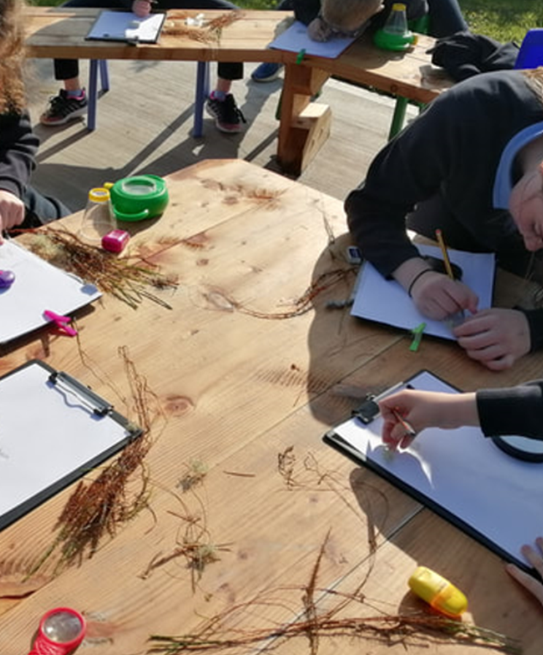
Understand – Your Schools Analysis
We recommend that you involve the whole school community in this process, including:
Children / Young People
Teachers / Staff
School Management
Parents / Guardians
Artists / Creative Practitioners who already work in your school

Slide 9
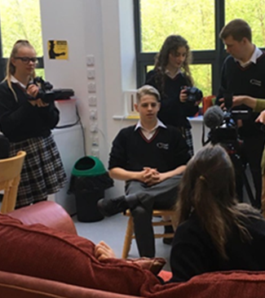
Understand document
The ‘Understand’ document consists of questions for you and your CA to consider and explore with your school community.
This document will help you to;
Analyse where your school is at now in terms of the arts and creativity
Capture creative conversations
Identify your schools strengths and areas for development.
Notes:
The Understand document is there to help analyse where your school is at now in terms of the arts and creativity. This document will enable you to capture creative conversations and consists of questions for you and your CA to consider and explore with your school community.
The results of the understand phase stay with your school and are not uploaded to the Arts Council. This shared analysis will enable you to identify your schools strengths and areas for development.

Slide 10
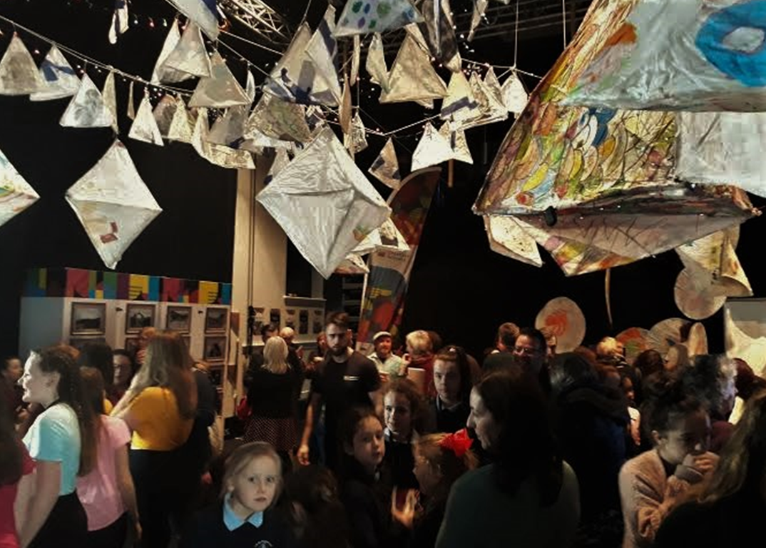
The Creative School Plan: A Living Document
Builds on schools strengths and areas for development linking to wider school planning.
Supports schools to plan for sustainable arts and creative activities.
Sets out long-term aspirations for the arts and creativity and what the school hopes to achieve.
Ensures that the voice of children and young people will be at the centre of the process.
Strengthens or develops relationships between schools and the arts & cultural sectors.
Identifies how success will be measured.
Notes:
The understand phase leads directly into the CS Plan
This document will help your school to begin to develop a vision and aims and begin to practically implement activities which support them.
The final version of the Plan is submitted to the Arts Council at the end of the 22/23 academic year.
The Plan is a living document that your school can develop further, adding to beyond your time in CS.

Slide 11
Creative School Plan: Three sections
1. Vision & Aims
Plan Summary
Activity Plan(s)
Notes:
This document will help your school to begin to develop a vision and aims and begin to practically implement activities which support them.
The final version of the Plan is submitted to the Arts Council at the end of the 22/23 academic year.

Slide 12
creativeschools@artscouncil.ie

